Slide 1



Singapore Community Help Social Network
Graduate Certificate in Intelligent Reasoning Systems
Project PROPOSAL presentation
SIVA KRISHNA THOTA

Slide 2
About The Project
Community help is a social network website based on Singapore to connect group of people and share useful information like other social network people can post tweets, likes and share text, images & videos through this website. Unlike other social networks, there is special feature which focus more on community interaction to help people and news sharing.
Features :
User is allowed to find near by shops/food courts in and around the community and can also explore on more offers.
Allow users to find friends in near by communities.
Merchants will receive the notifications if a user request for particular item from near by communities
Seller/Buyer can post and get the news or offers from near by community.
Based on history and interest user will get notifications on mobile app by tracking user location.
Similar like whatsup groups can be created in this application.

Slide 3
Business problem statement
Problem statement # 1
A specific popular form of online harassment is the use of abusive language. One abusive or toxic statement is being sent every 30 seconds across the globe. The use of abusive language on social media contributes to mental or emotional stress, with one in ten people developing such issues .These abusive Tweets and comments detection and deletion in social media is more important.
Problem statement # 2
Because human brains reply quickly to pictures and color in contrast to other types of information, an image is an almost invincible draw on social media. Of course, to get the concentration you want, you must share images that matter to your target audience. Although this may lead to mass data abuse images need to be detection and deletion in social media is more evitable.

Slide 4
Technical Problem Statement
Offensive Text and Image is pervasive in social media. Individuals frequently take advantage of the perceived anonymity of computer-mediated communication, using this to engage in behavior that many of them would not consider in real life. Online communities, social media platforms, and technology companies have been investing heavily in ways to cope with offensive language in the form of text or images to prevent abusive behavior in social media.
Problem statement # 1 Binary Category Classification The goal of this project is to improve abusive language detection with a focus on implicit abuse, to develop model using NLP techniques to accurately detect Abusive & and Non-Abusive language. Non-Abusive Language Abusive Text Language | Problem statement # 2 Image Classification This goal of the business use case derives to develop a model that uses Computer Vision techniques to accurately detect Abusive & and Non-Abusive Images. Safe Image Sexy Image Nude Image

Slide 5
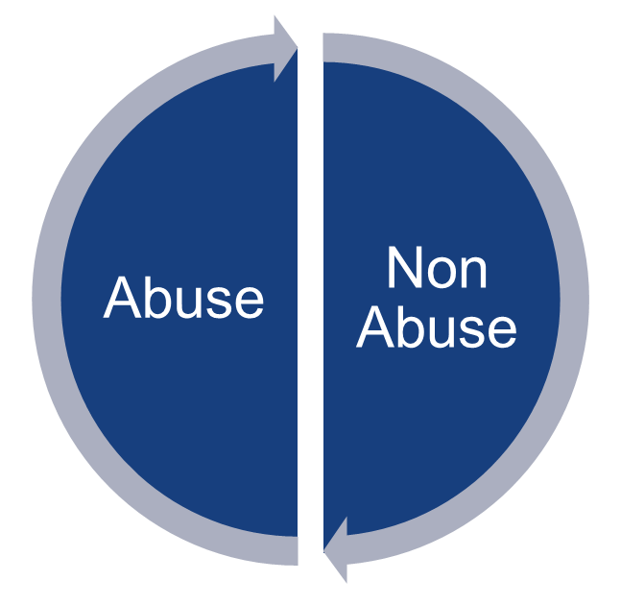
Dataset - Binary Category Classification
Process the train data carefully as the data has emojis, English texts, some symbols, links etc. Also, note that the language detected often is not correct so don't rely blindly on it.
Features like detected language of the text, total likes, total reports and views along with text are also provided. These features were not included by me during the training process.
Cleaned the data(remove emojis, punctuations etc.)
Trim the data acc to text lengths.
Below is the data set count from internet
Category | Count
Abuse | 48602
Non Abuse | 363235
Class imbalance is a common problem in machine learning that occurs when the distribution of examples within a dataset is skewed or biased. This can lead to a bias in the trained model, which can negatively impact its performance

Slide 6
About Dataset - Image Classification
we need work to prevent the spread of illegal child sexual abuse material (referred to as CSAM). Child safety organizations and governments rightly expect — and in many cases require — us to take action to remove it from our systems. Which is why, when we find CSAM on our platforms, we remove it, report it and often take the step to suspend the account.
Safe
Sexy
Nude
Category | Count
Safe Image | 38411
Sexy Image | 38005
Nude Image | 38000
Above is the data set count from internet

Slide 7

Application Flow Phase #1
Step #1
Step #2
Image
Message
NO
Step #8
Image Abuse
Detection
Step #4
Step #5
Step #7
Yes
Text Classification
Send Message
Rule Based
Engine
Step #3
Reply Back
To Sender
Text Abuse
Detection
Step #6
Emotion Detection
NO
Text Message
PYTHON
Practical Language
Processing
Intelligent Reasoning
Systems

Slide 8
Application Flowchart Phase #1
Post Message
Binary Category Classification / Binary Image Classification
Abusive
Non-Abusive
Rule Based Engine
Receive Message

Slide 9
Binary Category Classification approach
Data
Preprocess the data
Data Cleaning
EDA
Binary Class
Create word embeddings
Word2Vec
Glove
Train the model
LSTM
Bi-LSTM
CNN
Test and Predict

Slide 10
Image Classification approach
Images Data
Preprocess the data
Data Cleaning
EDA
Binary Class
Extract Features
Sift
LBP
Histogram
Train the model
CNN
VGG
ResNet
Test and Predict

Slide 11
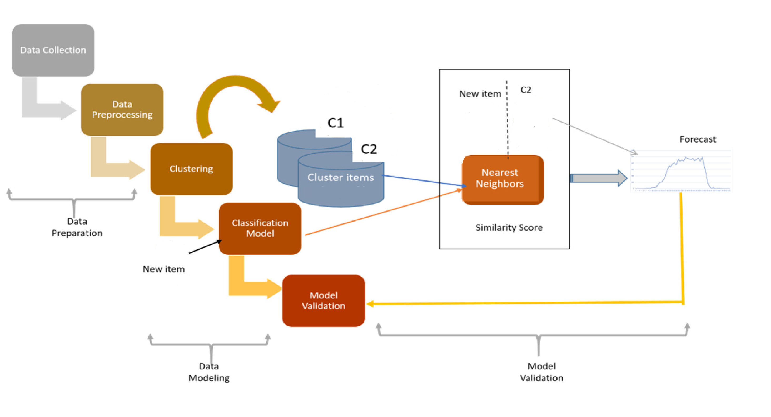
Experimental design

Slide 12
Continuous learning and improvements
Maintaining Machine Learning models
A Machine Learning model is a prediction machine that searches for patterns in data collected from various sources around the world and predicts future outcomes based on current observations. As the environment changes around us, so do the data patterns. ML models trained on historical data gradually become obsolete. As stated earlier, Machine Learning models work in dynamic data environments where data is constantly changing. “Concept drifts” are likely to happen, which would negatively impact the models’ accuracy if it’s not corrected, which is why it’s called “continual” learning.
Unfortunately, AI requires human intervention, constant maintenance, management, and course correction to provide meaningful output. For example, during the COVID-19 pandemic, many machine models malfunctioned during the shutdown due to the major shift from the norm.
According to Harvard Business Review, the impact on consumer behavior produced an unforeseen problem: an information gap, as data collected prior to the crisis, could no longer be used to predict future patterns accurately. The crucial component for retail customer loyalty programs, AI-driven product suggestions, and a wide range of critical business choices had a serious quality problem. Because of this, the ML models were required to be retrained.
To summarize, ensuring that you have the infrastructure and processes in place to acquire and update your models on a continuous basis is the key to ensuring that your Machine Learning model will be effective in the long run.

Slide 13
Continuous learning and improvements
Why should ML models be retrained?
As we near the end of this piece, here is a recap of some of the top reasons why ML models should be retrained:
Periodic retraining keeps an ML model up to date on the latest data.
ML models should be retrained on a regular basis. However, if there is no concept drift or significant reason for retraining, such as in the above-mentioned pandemic, this could be very costly in the long run.
Sometimes ML models dip below an acceptable threshold.
A major issue with this is that it takes a while to determine the ground truth, otherwise known as accurate data.
Data can become too dissimilar from the data the ML model was originally trained on.
To prevent this from happening, it’s essential to keep the team or individual who is aware of the initial data input in the loop.
Training methods :
We can continuously train a machine learning model in multiple ways.
Incremental training - training the model with new data as the data comes in (over the existing model).
Batch training - training the model once a significant amount of new data is available (over the existing model).
Retraining - retraining the entire model from scratch once a significant amount of data is available.
Every method has its pros and cons and is suitable for different scenarios. But all these methods come with an overhead that unless we have a process to automate it, will be tiring manual work. That’s where MLOps pipelines come into the picture.

Slide 14
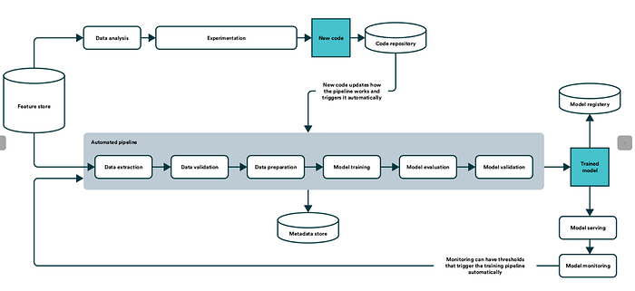
MLOps Pipeline
The MLOps has 4 core principles.
Continuous Integration (CI): In this stage, the continuous testing and validating of code, data, and models takes place.
Continuous Delivery (CD): In this stage, the delivery of an ML training pipeline that automatically deploys another ML model prediction service takes place.
Continuous Training (CT): In this stage, the automatically retraining ML models for redeployment take place.
Continuous Monitoring (CM): In this stage, the monitoring of production data and model performance metrics take place.
It is important to have all these 4 core principles covered while building a proper MLOps pipeline. But in this blog, we’ll look only at the Continuous Training part in detail.

Slide 15
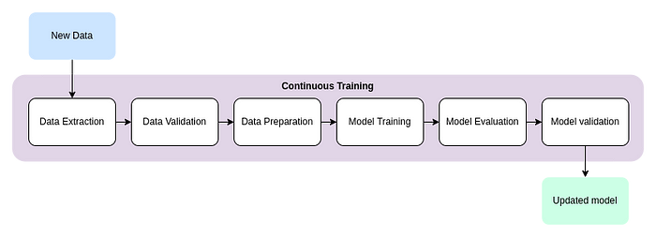
Continuous Training :
The Continuous Training process has 6 stages namely
Data Extraction — Extracting only the data that is needed from the data we get from the source.
Data Validation — Validating whether the data we extracted is present and is in the expected format.
Data Preparation — Processing the data to convert it into a suitable format to train the model.
Model Training — Training the Machine Learning model with the processed data.
Model Evaluation — Evaluating the metrics of the trained model.
Model Validation — Validating the new model’s predictions using the old/new data and comparing it with the old model’s predictions (A/B testing).
Optionally we can have a few modules to ease the training process. They are
Feature Store — A centralised place to store curated features for training the machine learning model. Feature stores let us reuse features instead of rebuilding these features every time.
Metadata Store — A centralised place to store the metadata about the trained model, its metrics and the data upon which it is trained, which can be used for future reference.
Model Registry — A centralised place to store every version of the model. It will come in handy if we need to go back to a previous model due to any unprecedented situations.

Slide 16
Triggers for Continuous Learning :
Triggers are used in a pipeline to retrain models with new data. The methods of triggering a pipeline include the following:
Ad-hoc manual triggering — Triggered manually by the developers.
Time-based — For example, if new data arrives into the system on a fixed schedule the pipeline can be executed after the arrival of new data.
Triggered when new data arrives — When ad-hoc data arrives at the data source it triggers the pipeline to retrain the model on the new data.
Model performance deterioration — If the model in production deteriorates beyond a pre-defined threshold it should trigger retraining of the model.
Data distribution changes — Significant changes in data distribution can trigger the pipeline to retrain the model.

Slide 17
Requirements Overview
Resource Requirements
Python
NumPy
Pandas
Matplotlib
Tensor Flow
Sklearn
Jupyter Notebook
Google Colab
GPU
NLP Techniques
Computer Vision Techniques
Spyder
Django Frame Work

Slide 18
Project deliverables With Effort Estimates
Web Site built with Python using the Django Web Framework, trivial templates with Bootstrap & jQuery for UI & UX, a RESTful API for the web client using Django Rest Framework.
Design database object using SQLite
Deep learning model for Abusive language detection
Deep learning model Abusive Images detection
Task | # Days
Design Web Project / DB Design | 30 Days
Data Collection | 10 Days
For Abusive language detection | 10 Days
Abusive Images detection | 10 Days

Slide 19

RESULT

Slide 20
Done So far
Problem statement # 1: Binary Category Classification
Completed Task
1. Data Clean & EDA.
2. Convert Text to vectors using different techniques like TFIDF ,Word2Vec
3. Trained Machine Learning and Deep Learning models.
4. Model Evaluation & Prediction using Test data
5. Model integration in community help website
6. Prediction using Real Time data
Model | Accuracy
XGB | 0.8551
MLP Word2Vec | 0.8815
XGB Word2Vec | 0.798
MLP | 0.8608

Slide 21
Done So far
Problem statement # 2: Image Classification
Completed Task
1. Data Clean & EDA.
2. Trained Machine Learning and Deep Learning models.
3. Model Evaluation & Prediction using Test data
4. Model integration in community help website
5. Prediction using Real Time data
Model | Accuracy
VGG Model #1 | 0.835
VGG Model #2 | 0.8208
resnet101 [ Stratergy-1 : freezing all layer's parameters ] | 0.85822
Resnet101 [ Stratergy-2 : freezing previous layers and training only last | 0.91019

Slide 22
References
https://medium.com/@sam.bell_43711/distracted-driver-detection-using-deep-learning-ecc7216ae8d0
https://github.com/Garima13a/YOLO-Object-Detection/blob/master/YOLO.ipynb
https://colab.research.google.com/github/d2l-ai/d2l-en-colab/blob/master/chapter_deep-learning-computation/use-gpu.ipynb#scrollTo=mwrEJrSCo-OR
https://github.com/opencv/opencv
https://github.com/prostasia/rocketchatcsam
https://github.com/kevintonb/child-abuse-image-classifier
https://github.com/swkarlekar/safecity/tree/master
https://github.com/bhaveshnaidu999/sexual-harassment-classification-project/tree/main

Slide 23


